Slide 1

视频压缩技术 Basic Video Compression Techniques
授课教师：张小燕
邮箱：xyzhang15@szu.edu.cn
2021年春季课程

Slide 2
知识点回顾
Image compression standard JPEG
Block diagram for JPEG encode
Transform RGB color model to YUV or YIQ
DCT coding for image block
Quantization of DCT coefficients
ZigZag scan for quantized DCT coefficients
DPCM for DC coefficients
RLC for AC coefficients
Entropy coding
JPEG file generation

Slide 3
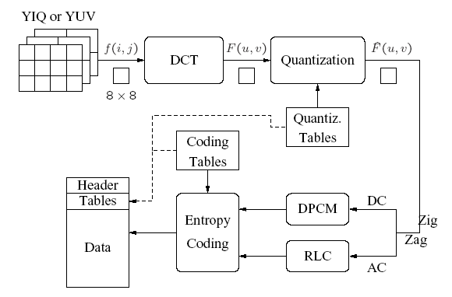
Block Diagram for JPEG Encode

Slide 4
Uniform Scalar Quantization
Motivation
Yield higher compression ratio
Main source for compression in JPEG
Quantize DCT coefficients
F(u,v) represents a DCT coefficients
Q(u,v) is a “quantization table" entry
represents the quantized DCT coefficients

Slide 5
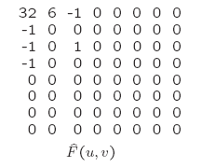
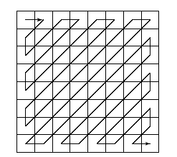
Zig-Zag Scan for Quantized DCT Coefficients
Zig-Zag scan
Zigzag scan result:
(32, 6,-1,-1,0 –1,0,0,0,-1,0,0,1,0,0… … 0)
To make it most likely to hit a long run of zeros: a zig-zag scan is used to turn the 8 × 8 matrix $\hat{F}$(u, v) into a 64-vector.

Slide 6
DPCM for DC Coefficients
Quantized DCT coefficients
DPCM is the coding method for DC coefficients
Differential Pulse Code Modulation （差分脉冲编码调制）
Example of encoding DC coefficients
assuming d_{i} = DC_{i+1} − DC_{i}, and d₀ = DC₀.
DC coefficients for the first 5 image blocks: 150,155, 149, 152, 144
Coding result: 150, 5, -6, 3, -8

Slide 7
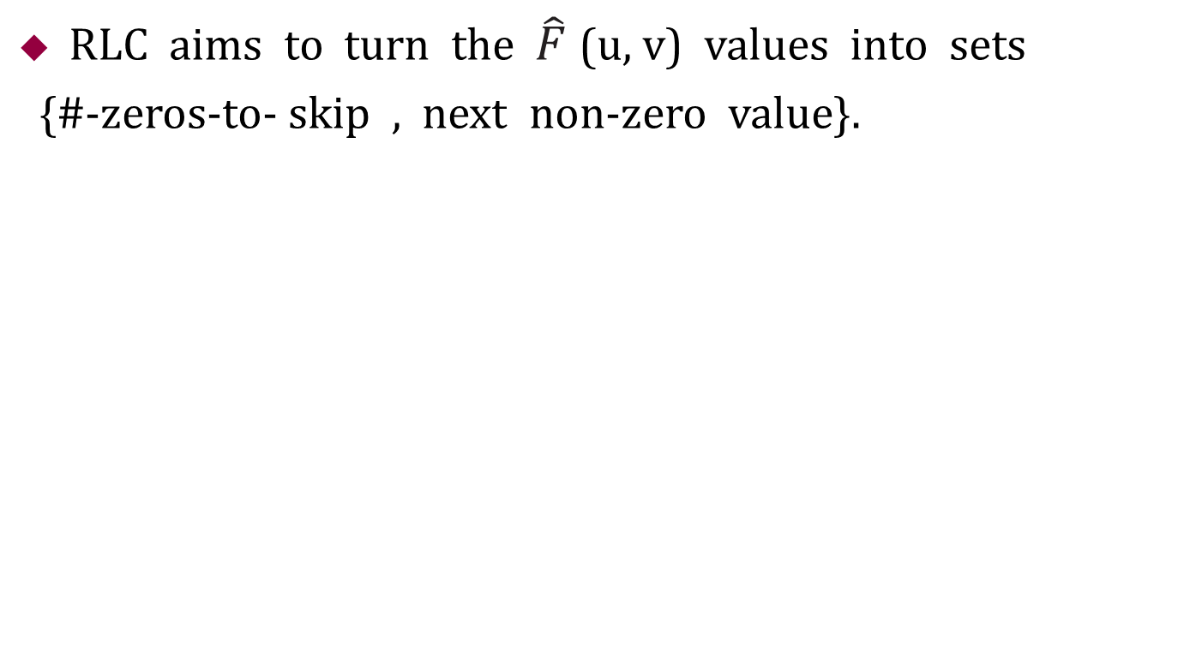
Run-length Coding (RLC, 游长编码) on AC coefficients
RLC aims to turn the $\hat{F}$(u, v) values into sets
{#-zeros-to- skip , next non-zero value}.
Zigzag scan result
(32, 6,-1,-1,0 –1,0,0,0,-1,0,0,1,0,0… … 0)
Modified Run-Length coding result
(0,6)(0,-1)(0,-1)(1,-1)(3,-1)(2,1)(0,0)

Slide 8
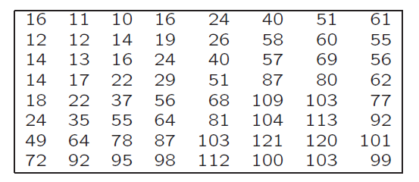
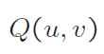
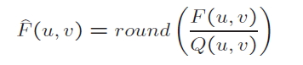
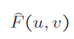
练习
1030 | 130 | -24 | 8 | 2 | 4 | -16 | 10
-32 | 6 | 4 | 0 | 0 | -22 | -4 | 6
-24 | 12 | 22 | -2 | 6 | 0 | 2 | -2
-16 | 6 | -8 | 4 | -4 | -6 | -10 | -4
0 | -4 | 14 | -10 | 8 | 0 | -2 | -8
0 | -3 | -2 | 0 | 8 | 2 | -2 | 0
6 | -4 | -6 | 6 | 6 | -2 | -2 | -6
-4 | 10 | -4 | 8 | -4 | 4 | -6 | 0
量化结果?
Z字扫描 的结果？
AC系数的游长编码？
F(u,v)

Slide 9
练习
64 | 12 | -2 | 1 | 0 | 0 | 0 | 0
-3 | 1 | 0 | 0 | 0 | 0 | 0 | 0
-2 | 1 | 1 | 0 | 0 | 0 | 0 | 0
-1 | 0 | 0 | 0 | 0 | 0 | 0 | 0
0 | 0 | 0 | 0 | 0 | 0 | 0 | 0
0 | 0 | 0 | 0 | 0 | 0 | 0 | 0
0 | 0 | 0 | 0 | 0 | 0 | 0 | 0
0 | 0 | 0 | 0 | 0 | 0 | 0 | 0
量化结果
Z字扫描的结果？
64， 12， -3， -2， 1， -2，1，0，1，-1，0，0，1，0，…0
AC系数的游长编码？
（0,12）（0，-3）（0，-2）（0,1）（0，-2）（0,1）（1,1）（0，-1）（2,1）（0,0）

Slide 10
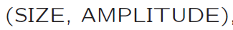
练习
DC系数：140, 75, 90, 120, 80, 45
DC系数的DPCM 编码？
140， -65，15，30，-40，-35
表示？
（8,10001100）（7，0111110）（4，1111）（5,11110）（6，010111）（6, 011100）

Slide 11
Outline of Lecture 10
Introduction to Video Compression
Video Compression with Motion Compensation
Motion Compensation
Sequential Search
Logarithmic Search
Hierarchical Search
Reference reading
Chapter 10

Slide 12
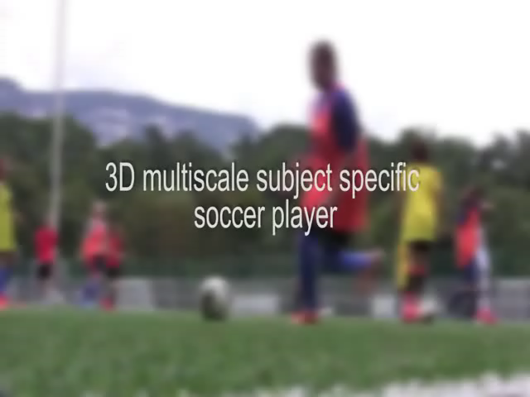
Introduction to Video Compression
A video consists of a time-ordered sequence of frames → images
An obvious solution to video compression would be predictive coding based on previous frames
Compression proceeds by subtracting images: subtract in time order and code the residual error

Slide 13
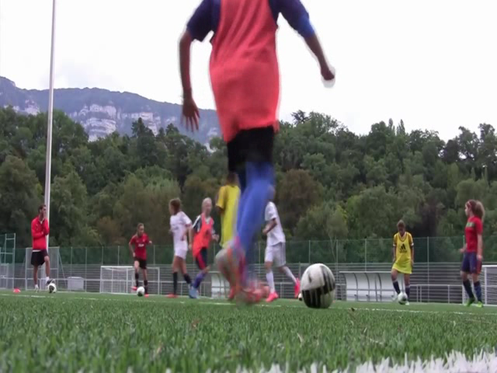
Introduction to Video Compression
An obvious solution to video compression would be predictive coding based on previous frames

Slide 14
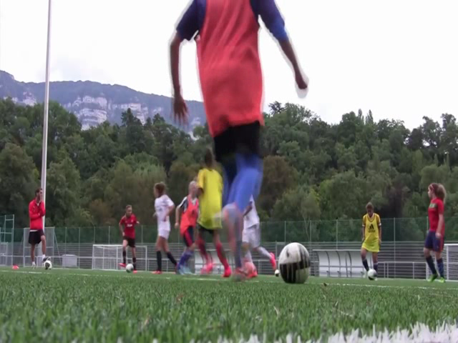
Introduction to Video Compression
An obvious solution to video compression would be predictive coding based on previous frames

Slide 15


Introduction to Video Compression
It can be done even better by searching for just the right parts of the image to subtract from the previous frame
Reference
Target

Slide 16
Outline of Lecture 10
Introduction to Video Compression
Video Compression with Motion Compensation
Motion Compensation
Sequential Search
Logarithmic Search
Hierarchical Search
Reference reading
Chapter 10

Slide 17
Video Compression with Motion Compensation (运动补偿)
Temporal redundancy (时间冗余) exists between consecutive (连续的) frames
Not every frame of the video needs to be coded independently (独立的) as a new image
The difference between the current frame and other frame(s) in the sequence will be coded.
Steps of video compression based motion compensation (MC)
Motion estimation
MC-based prediction
Derivation of the prediction error

Slide 18
Outline of Lecture 10
Introduction to Video Compression
Video Compression with Motion Compensation
Motion Compensation
Sequential Search
Logarithmic Search
Hierarchical Search
Reference reading
Chapter 10

Slide 19
Motion Compensation
Each image is divided into macroblocks（宏块）of size N × N .
By default, N = 16 for luminance images.
For chrominance images, N = 8 if 4:2:0 chroma subsampling is adopted.
Motion compensation is performed at the macroblock level.
The current image frame is referred to as Target Frame.
A match is sought between the macroblock in the Target Frame and the most similar macroblock in previous and/or future frame(s) (referred to as Reference frame(s)).
The displacement of the reference macroblock to the target mac- roblock is called a motion vector MV.

Slide 20
Macroblocks and Motion Vector in Video Compression
MV search is usually limited to a small immediate neighborhood — both horizontal and vertical displacements in the range [−p, p].
This makes a search window of size (2p + 1) × (2p + 1).

Slide 21
Search for Motion Vectors
Calculating the displacement of the reference macroblock to the target macroblock
Reference image
Target image

Slide 22
Search for Motion Vectors
The difference between two macroblocks can be measured by Mean Absolute Difference (MAD)，平均绝对误差
The goal of the search is to find a vector (i, j) as the motion vector MV = (u,v), such that MAD(i, j) is minimum
(u, v) = [ (i, j) | M AD(i, j) is minimum, i ∈ [−p, p], j ∈ [−p, p] ]

Slide 23
Mean Absolute Difference (MAD)
100
10
Reference
Target
Calculate MAD：
MAD=(|10-100|+|10-100|+7* |10-10|+7* |100-100|)/16=180/16

Slide 24
Outline of Lecture 10
Introduction to Video Compression
Video Compression with Motion Compensation
Motion Compensation
Sequential Search
Logarithmic Search
Hierarchical Search
Reference reading
Chapter 10

Slide 25
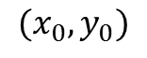
Sequential Search （顺序搜索）
-P
P=7
N=5
-P
+P

Slide 26
Sequential Search （顺序搜索）
Sequential search: sequentially search the whole (2p+1)×(2p+1) window in the Reference frame
The vector (i, j) that offers the least M AD is designated as the MV (u, v) for the macroblock in the Target frame.
This method is costly — assuming each pixel comparison requires three operations (subtraction, absolute value, addition), the cost for obtaining a motion vector for a single macroblock is
(2p+1)·(2p+1)·N²·3 ⇒ O(p²N²)

Slide 27
Sequential Search （顺序搜索）
Full-pixel position Half-pixel position
A
B
a
b
See demo predictionMC.m
c
d
思考：MV（u，v）只能为整数吗？
C
D
Half-pixel Prediction by Bilinear Interpolation in H.263

Slide 28
Outline of Lecture 12
Introduction to Video Compression
Video Compression with Motion Compensation
Motion Compensation
Sequential Search
Logarithmic Search
Hierarchical Search
Reference reading
Chapter 10

Slide 29
2D Logarithmic Search
Logarithmic search: a cheaper version, which is suboptimal but usually effective
The procedure for 2D Logarithmic search takes several iterations (迭代) and is akin to a binary search
Initially only nine locations in the search window are used as seeds for a MAD-based search
After the one that yields the minimum MAD is located, the center of the new search region is moved to it and the step-size (“offset”) is reduced to half
In the next iteration, the nine new locations are marked as ‘2’, and so on.

Slide 30
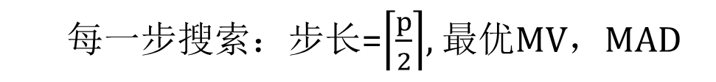
2D Logarithmic Search for Motion Vectors
The total operations per second is dropped to:
O(log p*N²)
每一步搜索：步长=$\left\lceil \frac{p}{2}\right\rceil$, 最优MV，MAD

Slide 31
Algorithm of 2D-Logarithmic Search

Slide 32
Outline of Lecture 12
Introduction to Video Compression
Video Compression with Motion Compensation
Motion Compensation
Sequential Search
Logarithmic Search
Hierarchical Search
Reference reading
Chapter 10

Slide 33
Hierarchical Search （分层搜索）
Sequential search method is very costly
(2p+ 1)· (2p+ 1)· N ² · 3 ⇒ O(p²N ²)
Reduce p and N, could reduce the cost.
The search can benefit from a hierarchical (multiresolution) approach in which initial estimation of the motion vector can be obtained from images with a significantly reduced resolution.

Slide 34
A Three-level Hierarchical Search for Motion Vectors
Original image is at Level 0, images at Levels 1 and 2 are obtained by down-sampling from the previous levels by a factor of 2, and the initial search is conducted at Level 2.
Since the size of the macroblock is smaller and p can also be proportionally reduced, the number of operations required is greatly reduced.

Slide 35
Comparison of Computational Cost
Search Method | OP S per second for 720 × 480 at 30 fps
 | p = 15 | p = 7
Sequential search | 29.89 × 10⁹ | 7.00 × 10⁹
2D Logarithmic search | 1.25 × 10⁹ | 0.78 × 10⁹
3-level Hierarchical search | 0.51 × 10⁹ | 0.40 × 10⁹

Slide 36
练习题

Slide 37
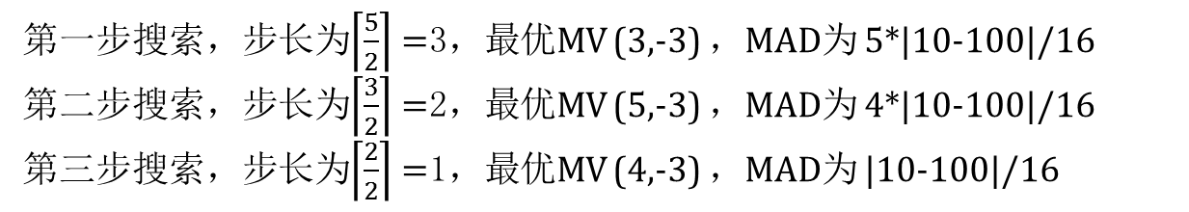
练习题
x
2
2
2
3
3
3
1
1
2
1
3
2
3
3
3
3
2
2
2
1
1
1
1
1
y

